Slide 1
Makram-Ebeid-Lannoo Model based Phonon-assisted Tunneling Emission Modeling 20241031 진명

Slide 2
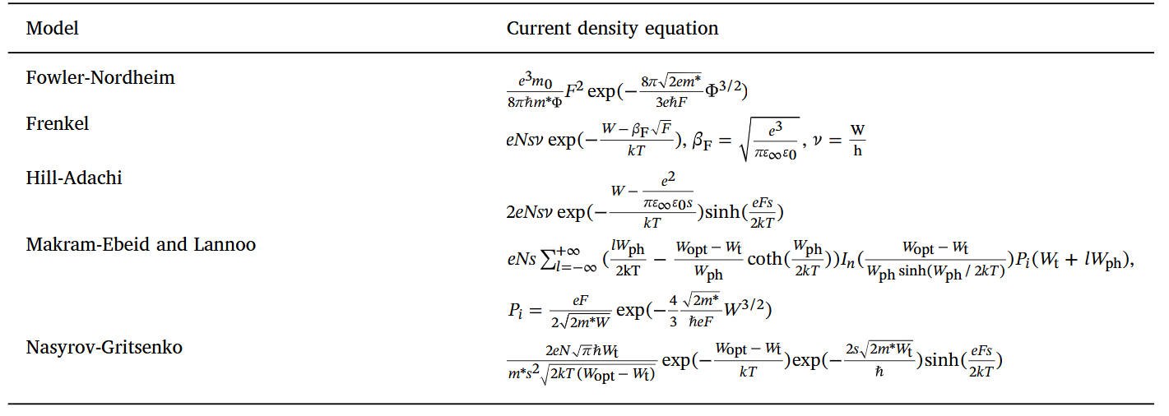
Trap-Assisted Current Model
[1] Voronkovskii, Journal of Non-Crystalline Solids 546 (2020)
Makram-Ebeid-Lannoo model selected
TCAD adaptable
Electron-phonon coupling : thermal dependency

Slide 3
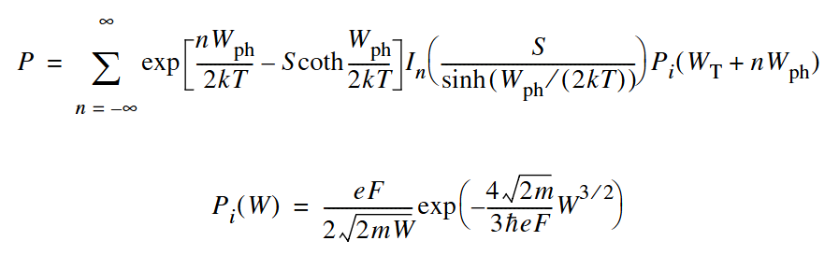
Makram-Ebeid-Lannoo Model
[2] Synopsys Sentaurus TCAD sdevice manual 2016.3
: electron-phonon interaction average energy
: quantum tunneling emission rate

Slide 4
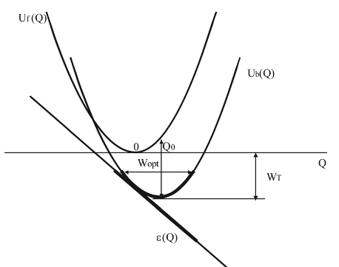
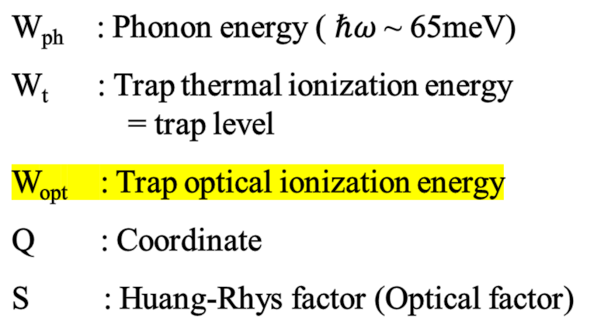
Makram-Ebeid-Lannoo Model
Unoccupied trap
Occupied trap
W_{ph} : Phonon energy ( $ℏω$~ 65meV)
W_{t} : Trap thermal ionization energy = trap level
W_{opt} : Trap optical ionization energy
Q : Coordinate
S : Huang-Rhys factor (Optical factor)
Electron capture in oscillator model

Slide 5
Shallow Trap TCAD-Model Comparison
Fitting under detrap retention of shallow trap (0.6eV, 0.8eV)
Shallow trap fitting: W_{opt} = E_{t} + 0.6 [eV]

Slide 6
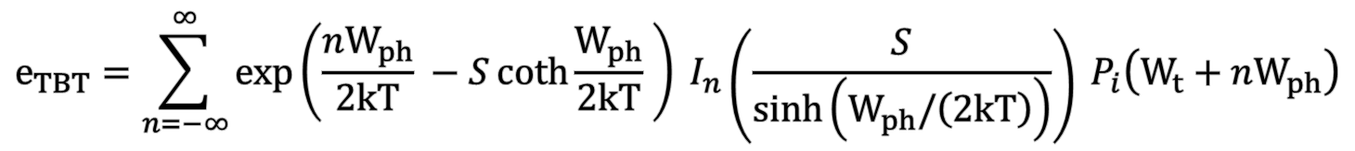
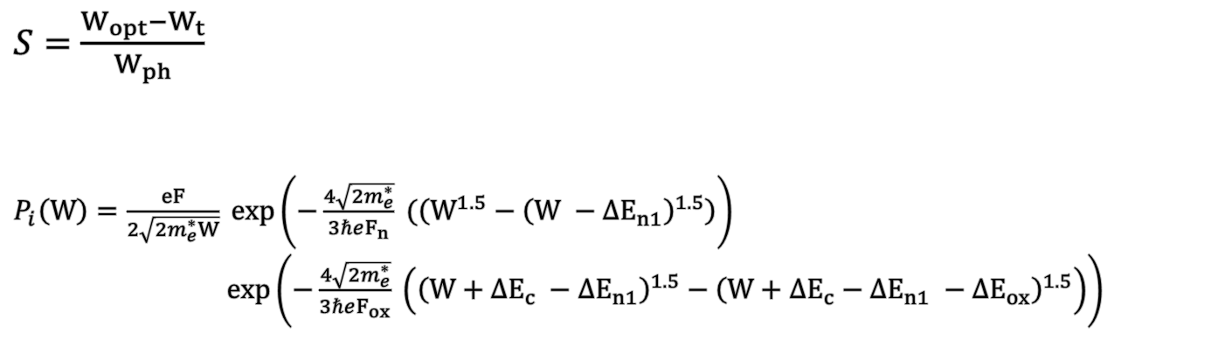
Model Specification
: Makram-Ebeid-Lannoo Model
Model Specification under 3D NAND Flash detrap retention
$$e_{TBT}=\sum_{n=−∞}^{∞}{\exp\left(\frac{nW_{ph}}{2kT} −S\coth{\frac{W_{ph}}{2kT}} \right) I_{n}\left(\frac{S}{\sinh\left(W_{ph}/\left(2kT\right)\right)}\right) P_{i}\left(W_{t}+nW_{ph}\right)}$$
$S=\frac{W_{opt}−W_{t}}{W_{ph}}$
$P_{i}\left(W\right)=\frac{eF}{2\sqrt{2m_{e}^{∗}W}} exp\left(−\frac{4\sqrt{2m_{e}^{∗}}}{3ℏeF_{n}} (\left(W^{1.5}−{\left(W −ΔE_{n1}\right)}^{1.5}\right)\right)$
$\exp\left(−\frac{4\sqrt{2m_{e}^{∗}}}{3ℏeF_{ox}} \left({\left(W+ΔE_{c} −ΔE_{n1}\right)}^{1.5}−{\left(W+ΔE_{c}−ΔE_{n1} −ΔE_{ox}\right)}^{1.5}\right)\right)$
S : Huang-Rhys factor
P_{i} (W) : Tunneling coefficient of BETOX detrapping tunneling
for electron energy level at W

Slide 7

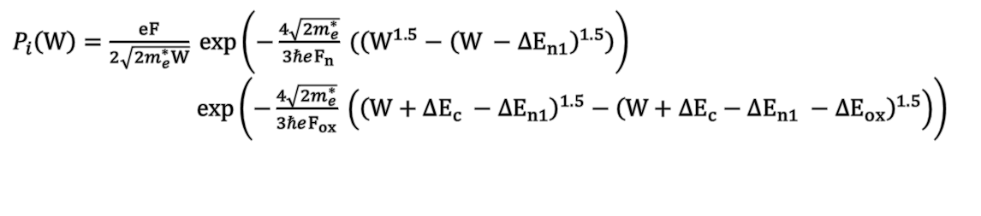
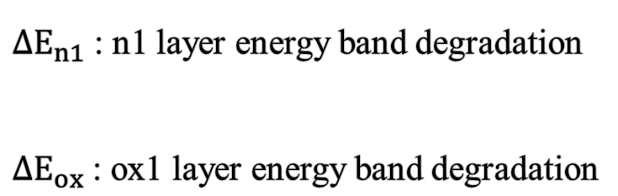


Model Specification
Tunneling ionization rate calculation
BE-TOX (ONO)
$ΔE_{n1}$ : n1 layer energy band degradation
$ΔE_{ox}$ : ox1 layer energy band degradation
CTN
ox1 layer
ox2 layer
n1 layer
$ΔE_{ox}$
$ΔE_{n1}$
$P_{i}\left(W\right)=\frac{eF}{2\sqrt{2m_{e}^{∗}W}} exp\left(−\frac{4\sqrt{2m_{e}^{∗}}}{3ℏeF_{n}} (\left(W^{1.5}−{\left(W −ΔE_{n1}\right)}^{1.5}\right)\right)$
$\exp\left(−\frac{4\sqrt{2m_{e}^{∗}}}{3ℏeF_{ox}} \left({\left(W+ΔE_{c} −ΔE_{n1}\right)}^{1.5}−{\left(W+ΔE_{c}−ΔE_{n1} −ΔE_{ox}\right)}^{1.5}\right)\right)$

Slide 8
Future Works
Deep trap emission TCAD simulation & MEL model W_{opt} fitting
W_{opt} physical meaning
MEL-model based phonon-assisted Trap-Trap conduction Simulation
Pure tunneling compact modeling
…
…
…
…
$e_{PT}=ν_{PT} {\left(TC\right)}_{PT}$ : attempt-to-escape frequency compact modeling

